Slide 1
INFO251 – Applied Machine Learning
Lab 12
Qutub Khan Vajihi

Slide 2
Announcements
PS7 launched! Due on May 5th, 11:59PM.
You will be working on Unsupervised Learning and Face Recognition.
The problem is open ended and will require some compute, so start early!

Slide 3
Agenda
Unsupervised Learning
K-Means Clustering
Dimensionality Reduction

Slide 4
Unsupervised Learning
Labeled data is absent!
Also labeled data is not always easy to get. Sometimes $$$!
Sometimes used as pre-processing before supervised learning
Lots of different applications –
Market Segmentation
Image Segmentation
Recommender Systems
Used in a lot of modern deep learning – GPT2/3

Slide 5
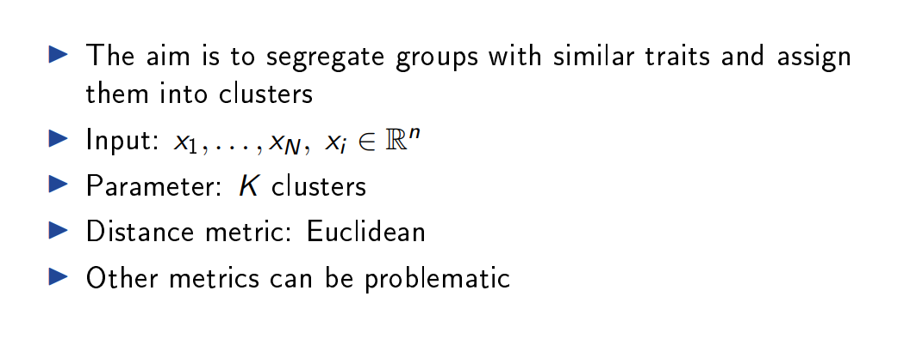
k-Means : Recap

Slide 6
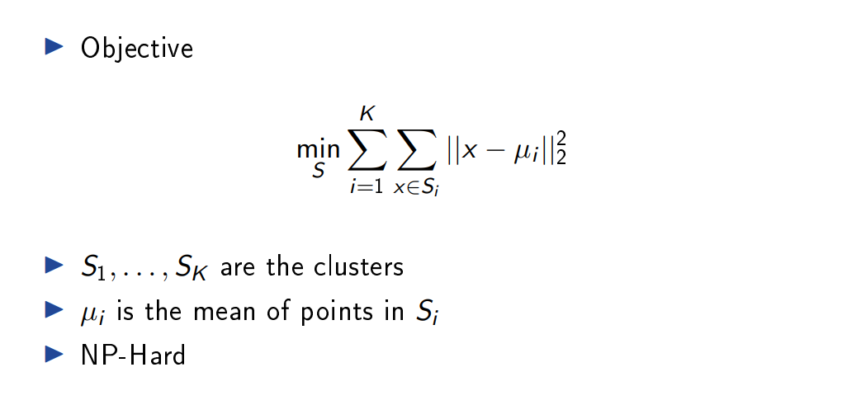
k-Means : Recap

Slide 7
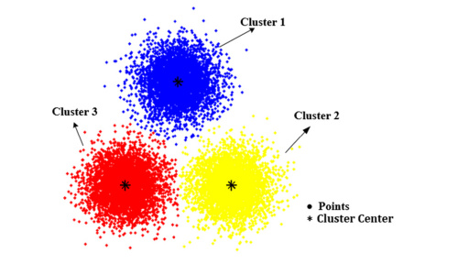
k-Means : Algorithm
Choose centroids
Assign each data point to nearest centroid
Re-align centroid to center of mass
Repeat 2+2 until complete.

Slide 8
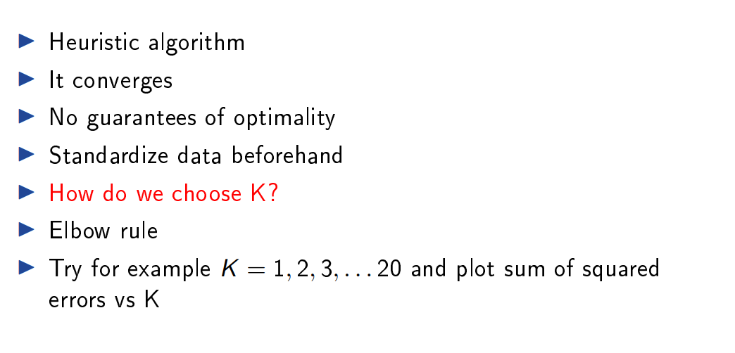
k-Means

Slide 9
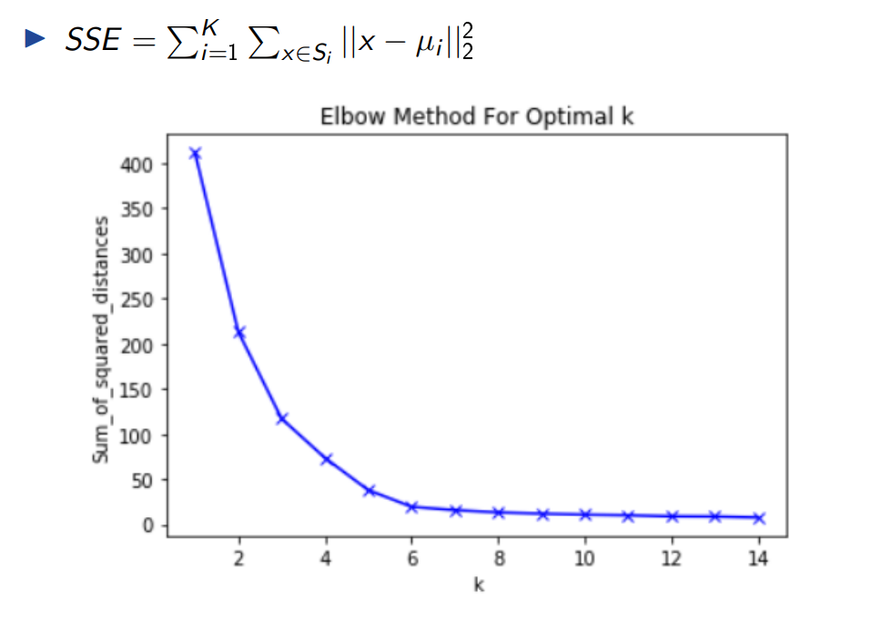
k-Means : Elbow Method

Slide 10
Dimensionality Reduction
Why?
Handle “curse of dimensionality”
Help reduce overfitting
Very useful for data visualization
Read more about methods like DBSCAN and t-SNE here
Data Compression

Slide 11
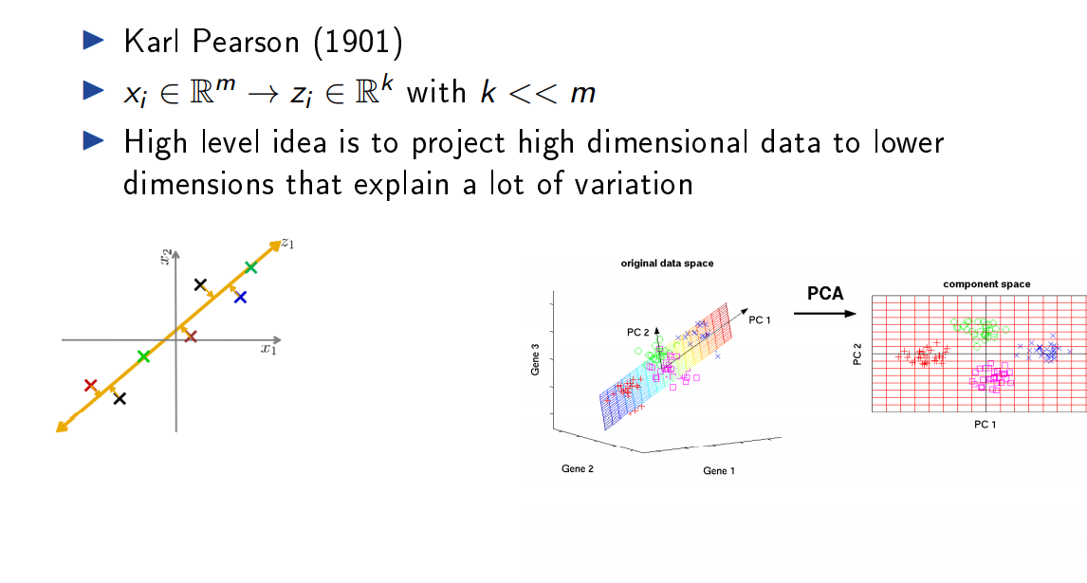
PCA

Slide 12
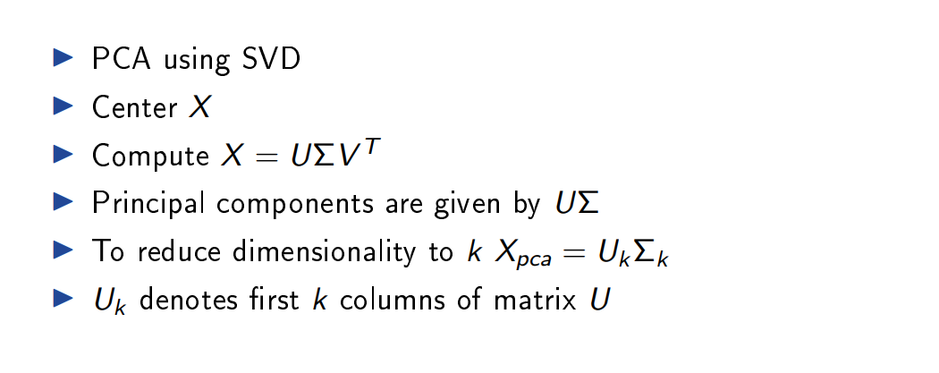
PCA – The essentials

Slide 13
Over to the notebook

